Slide 1


Employee Attrition Factors What financial/non-financial factors cause an employee to leave a company? What can you do to make them stay?
Falak jain, Antonius Raharja, Pranay Bhaskar Mallipudi, Shailendra Narwaria, Vania Ibrahim

Slide 2
The Importance of Employees
“To win in the marketplace you first must win in the workplace” - Doug Conant, Former CEO of Campbell Soup Company
Drawbacks of High Attrition Rates
01
Hiring Cost
More expenses will be accrued to find and hire a replacement
Impacts the functional department, as well as HR, Legal etc.
02
Time and Resources Cost
The company will need to dedicate more time and resources to train the new hire
Less time to be productive and accomplish business goals
03
Low Morality
The event of employee attrition brings concerns and worries to the remaining employees, leading to low morality
May lead to more employees leaving the company due to excessive workload and stress

Slide 3
Goal
Introduce a dashboard for businesses to recognize financial/non-financial factors which led specific employees to attrite based on historical data. The dashboard also includes a tool to predict the chances of a certain employees to attrite.

Slide 4
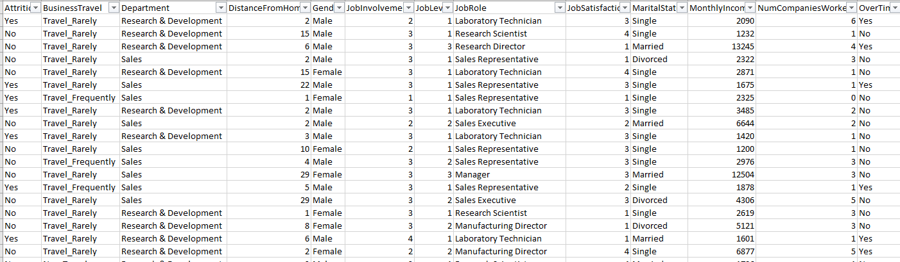
Dataset
Source: IBM Attrition Dataset (from Kaggle)
Each row of data contains details of one (1) employee that has attrite or not
Each column provides general insights of the employee’s career history

Slide 5
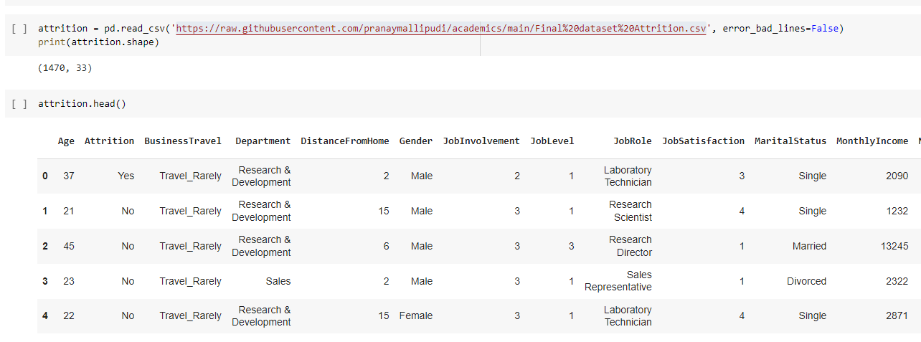
Data Extraction
Our raw dataset includes 1,470 rows and 33 columns

Slide 6
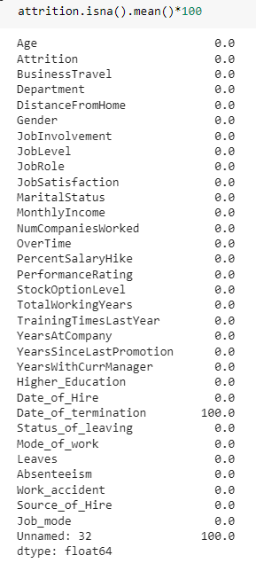
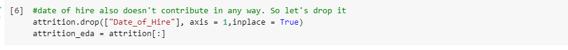
Data Cleaning
Checking for null values from the raw dataset
As both the columns ‘Date_of_termination’ and ‘Unnamed: 32’ are blanks, we dropped these 2 columns from the dataset
Since the ‘Date_of_termination’ column is blank, there will be no use for the ‘Date_of_hire’ column. As such, we dropped that column as well.

Slide 7
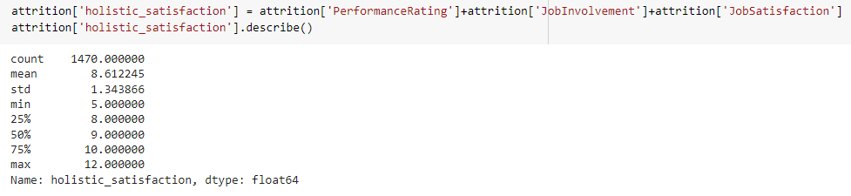
Feature Engineering
We identified 3 different columns with numerical values that would describe if an employee’s satisfaction level overall. Each column has value ranges from 1-4.
We decided to aggregate these columns and create a ‘holistic_satisfaction’ columns to use in our analysis. Upon aggregation, we identified that an average employee has an average of 8.6 holistic satisfaction number.

Slide 8
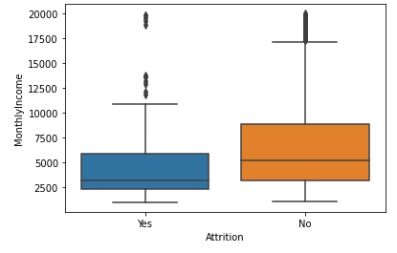
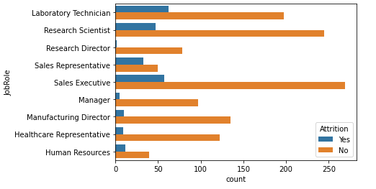
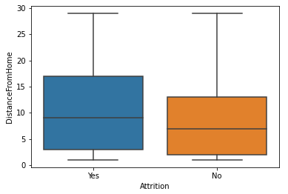
Exploratory Data Analysis

Slide 9
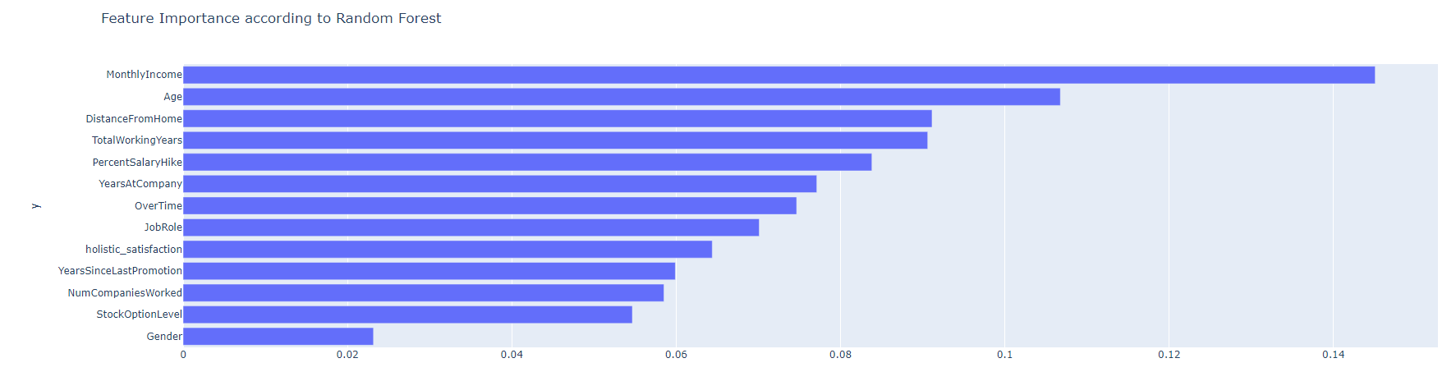
Feature Importance from Random Forest

Slide 10
DASHBOARD PRESENTATION
Key Metrics

Slide 11
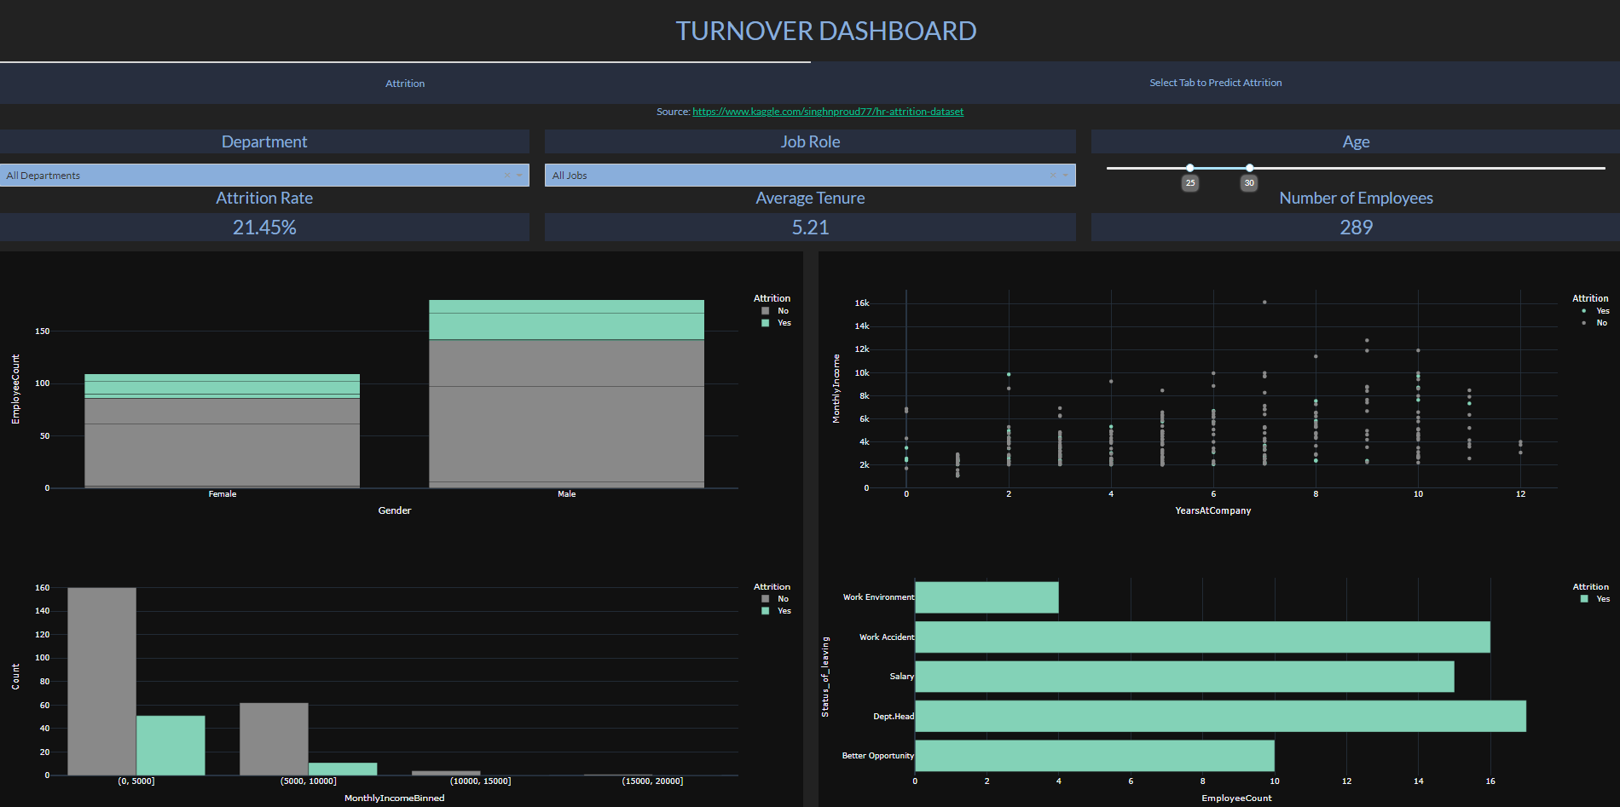
Dashboard Layout Tab 1

Slide 12
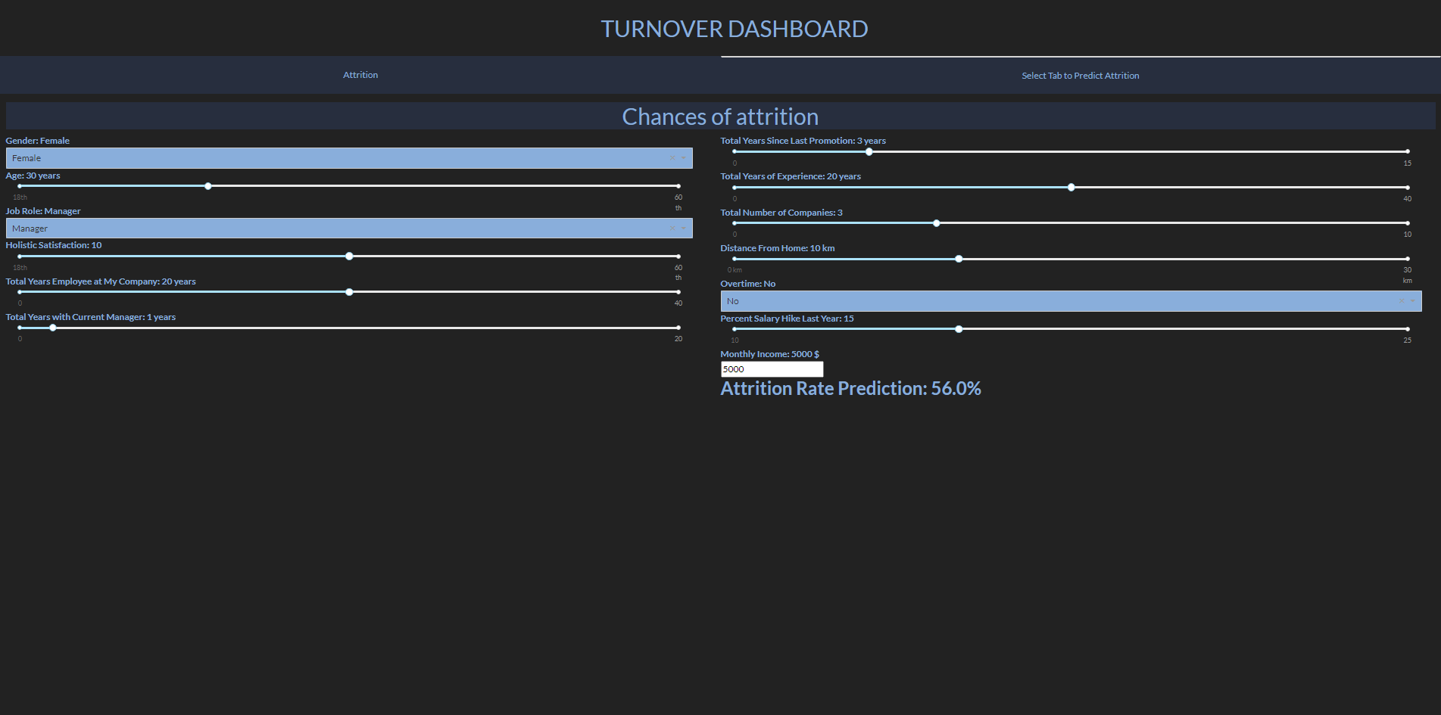
Dashboard Layout Tab 2

Slide 13
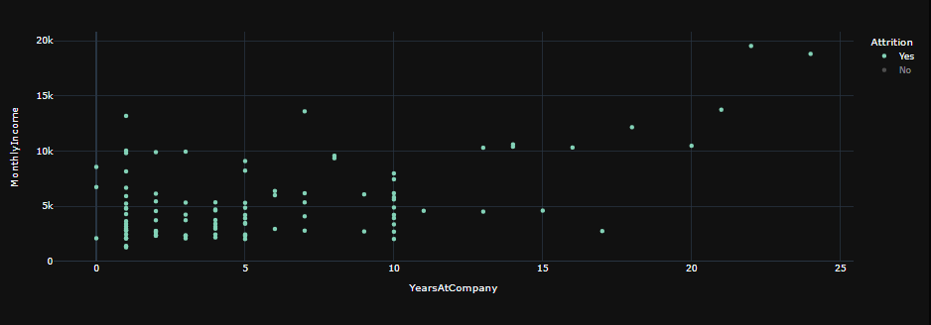
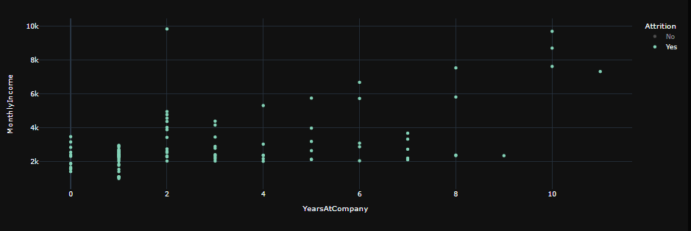
Key Metrics: Age 18-30 vs 31-45 for all Departments & Role
Age 18-30
Age 31-45

Slide 14
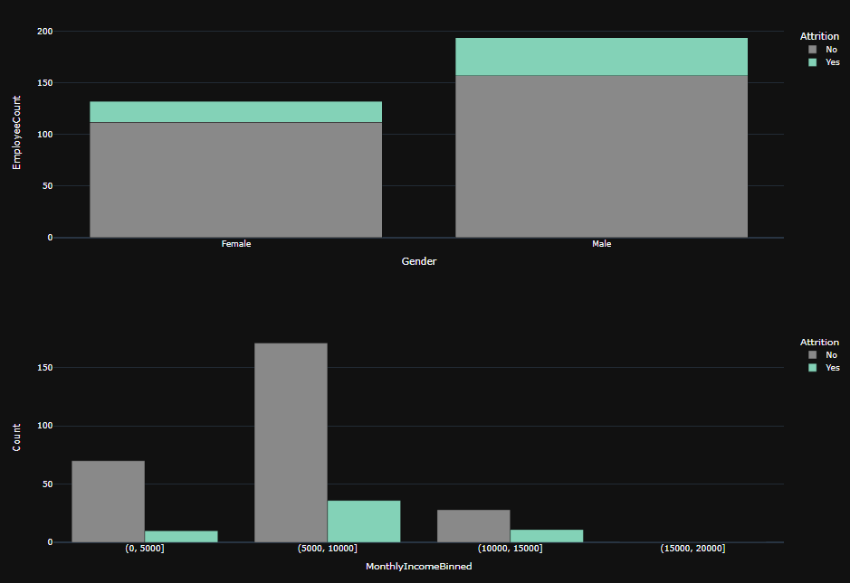
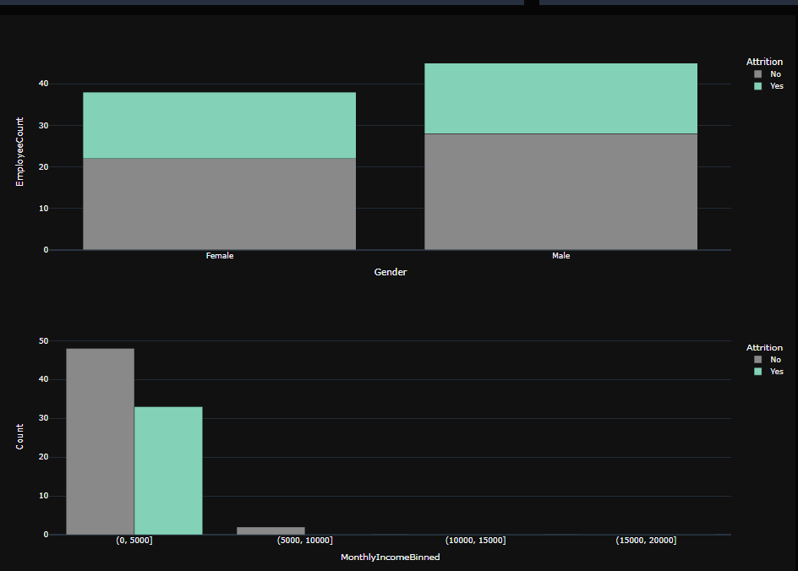
Key Metrics: Sales Executive vs Sales Representative
Sales Executive
Sales Representative

Slide 15
Conclusion
Attrition is a critical topic for most companies as all businesses rely on employees
Assist companies through data-driven decision making approach
Hiring decision
Predict whether certain employees have a high chance to attrite based on historical data

Slide 16
References
Reddy, Chitra, et al. “Employee Attrition or Turnover Advantages & Disadvantages.” WiseStep, 25 June 2018,
https://content.wisestep.com/employee-attrition-turnover-advantages-disadvantages/.

Slide 17
Appendix
For the full code related to our dashboard and EDA process:
Dashboard: “dashboard_latest.ipynb”
EDA/Random Forest Classifier: “DSO 545 project EDA and RF model.ipynb”
Raw dataset source: IBM Attrition Dataset (from Kaggle)

